Slide 1
TIDEHAVEN WIT
2019-2020

Slide 2
Inductions

Slide 3
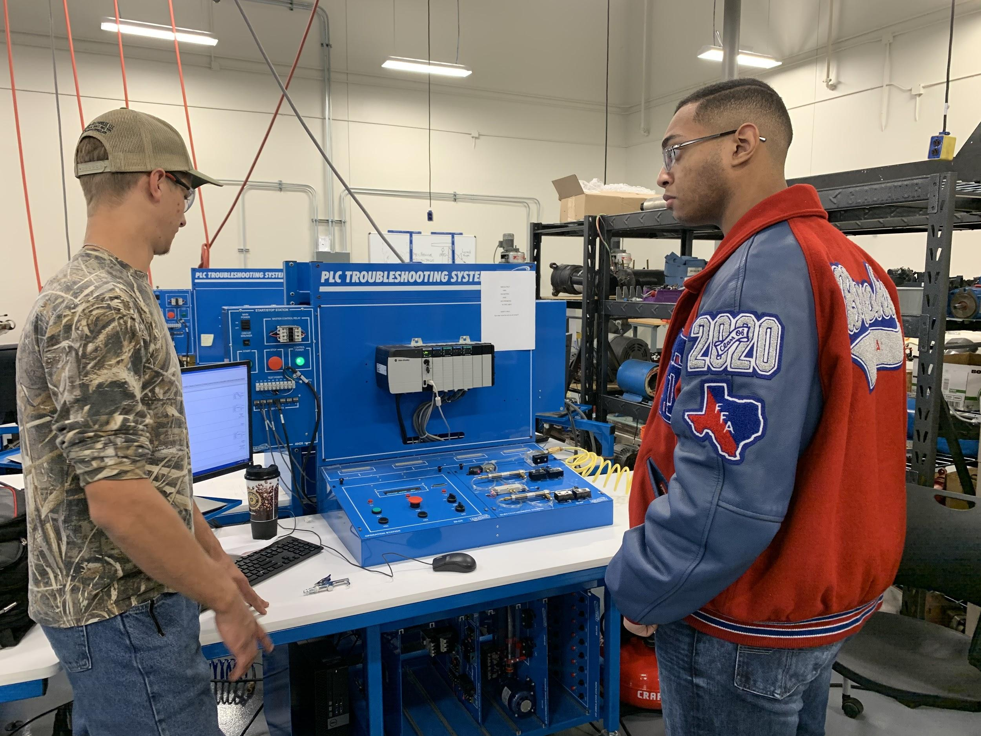
TSTC Engineering and Tech Day

Slide 4
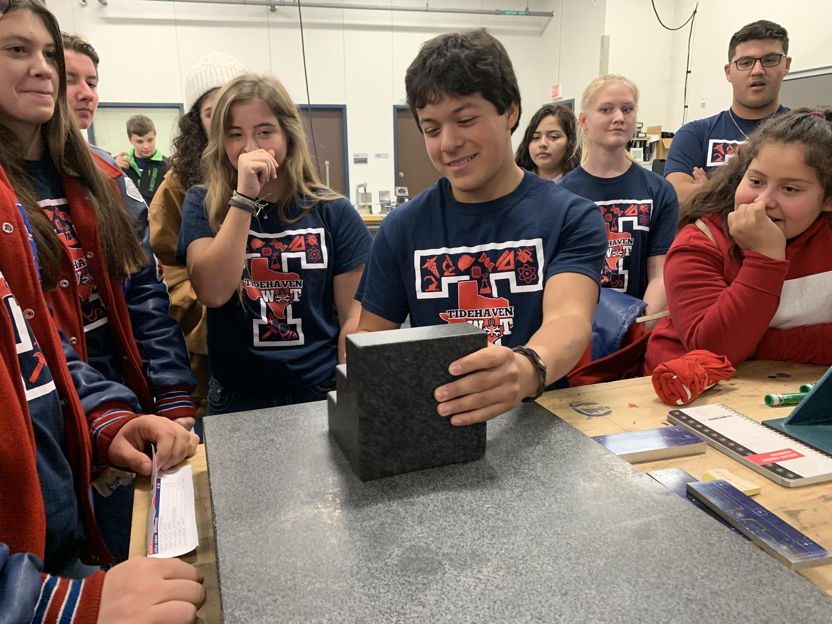

Slide 5
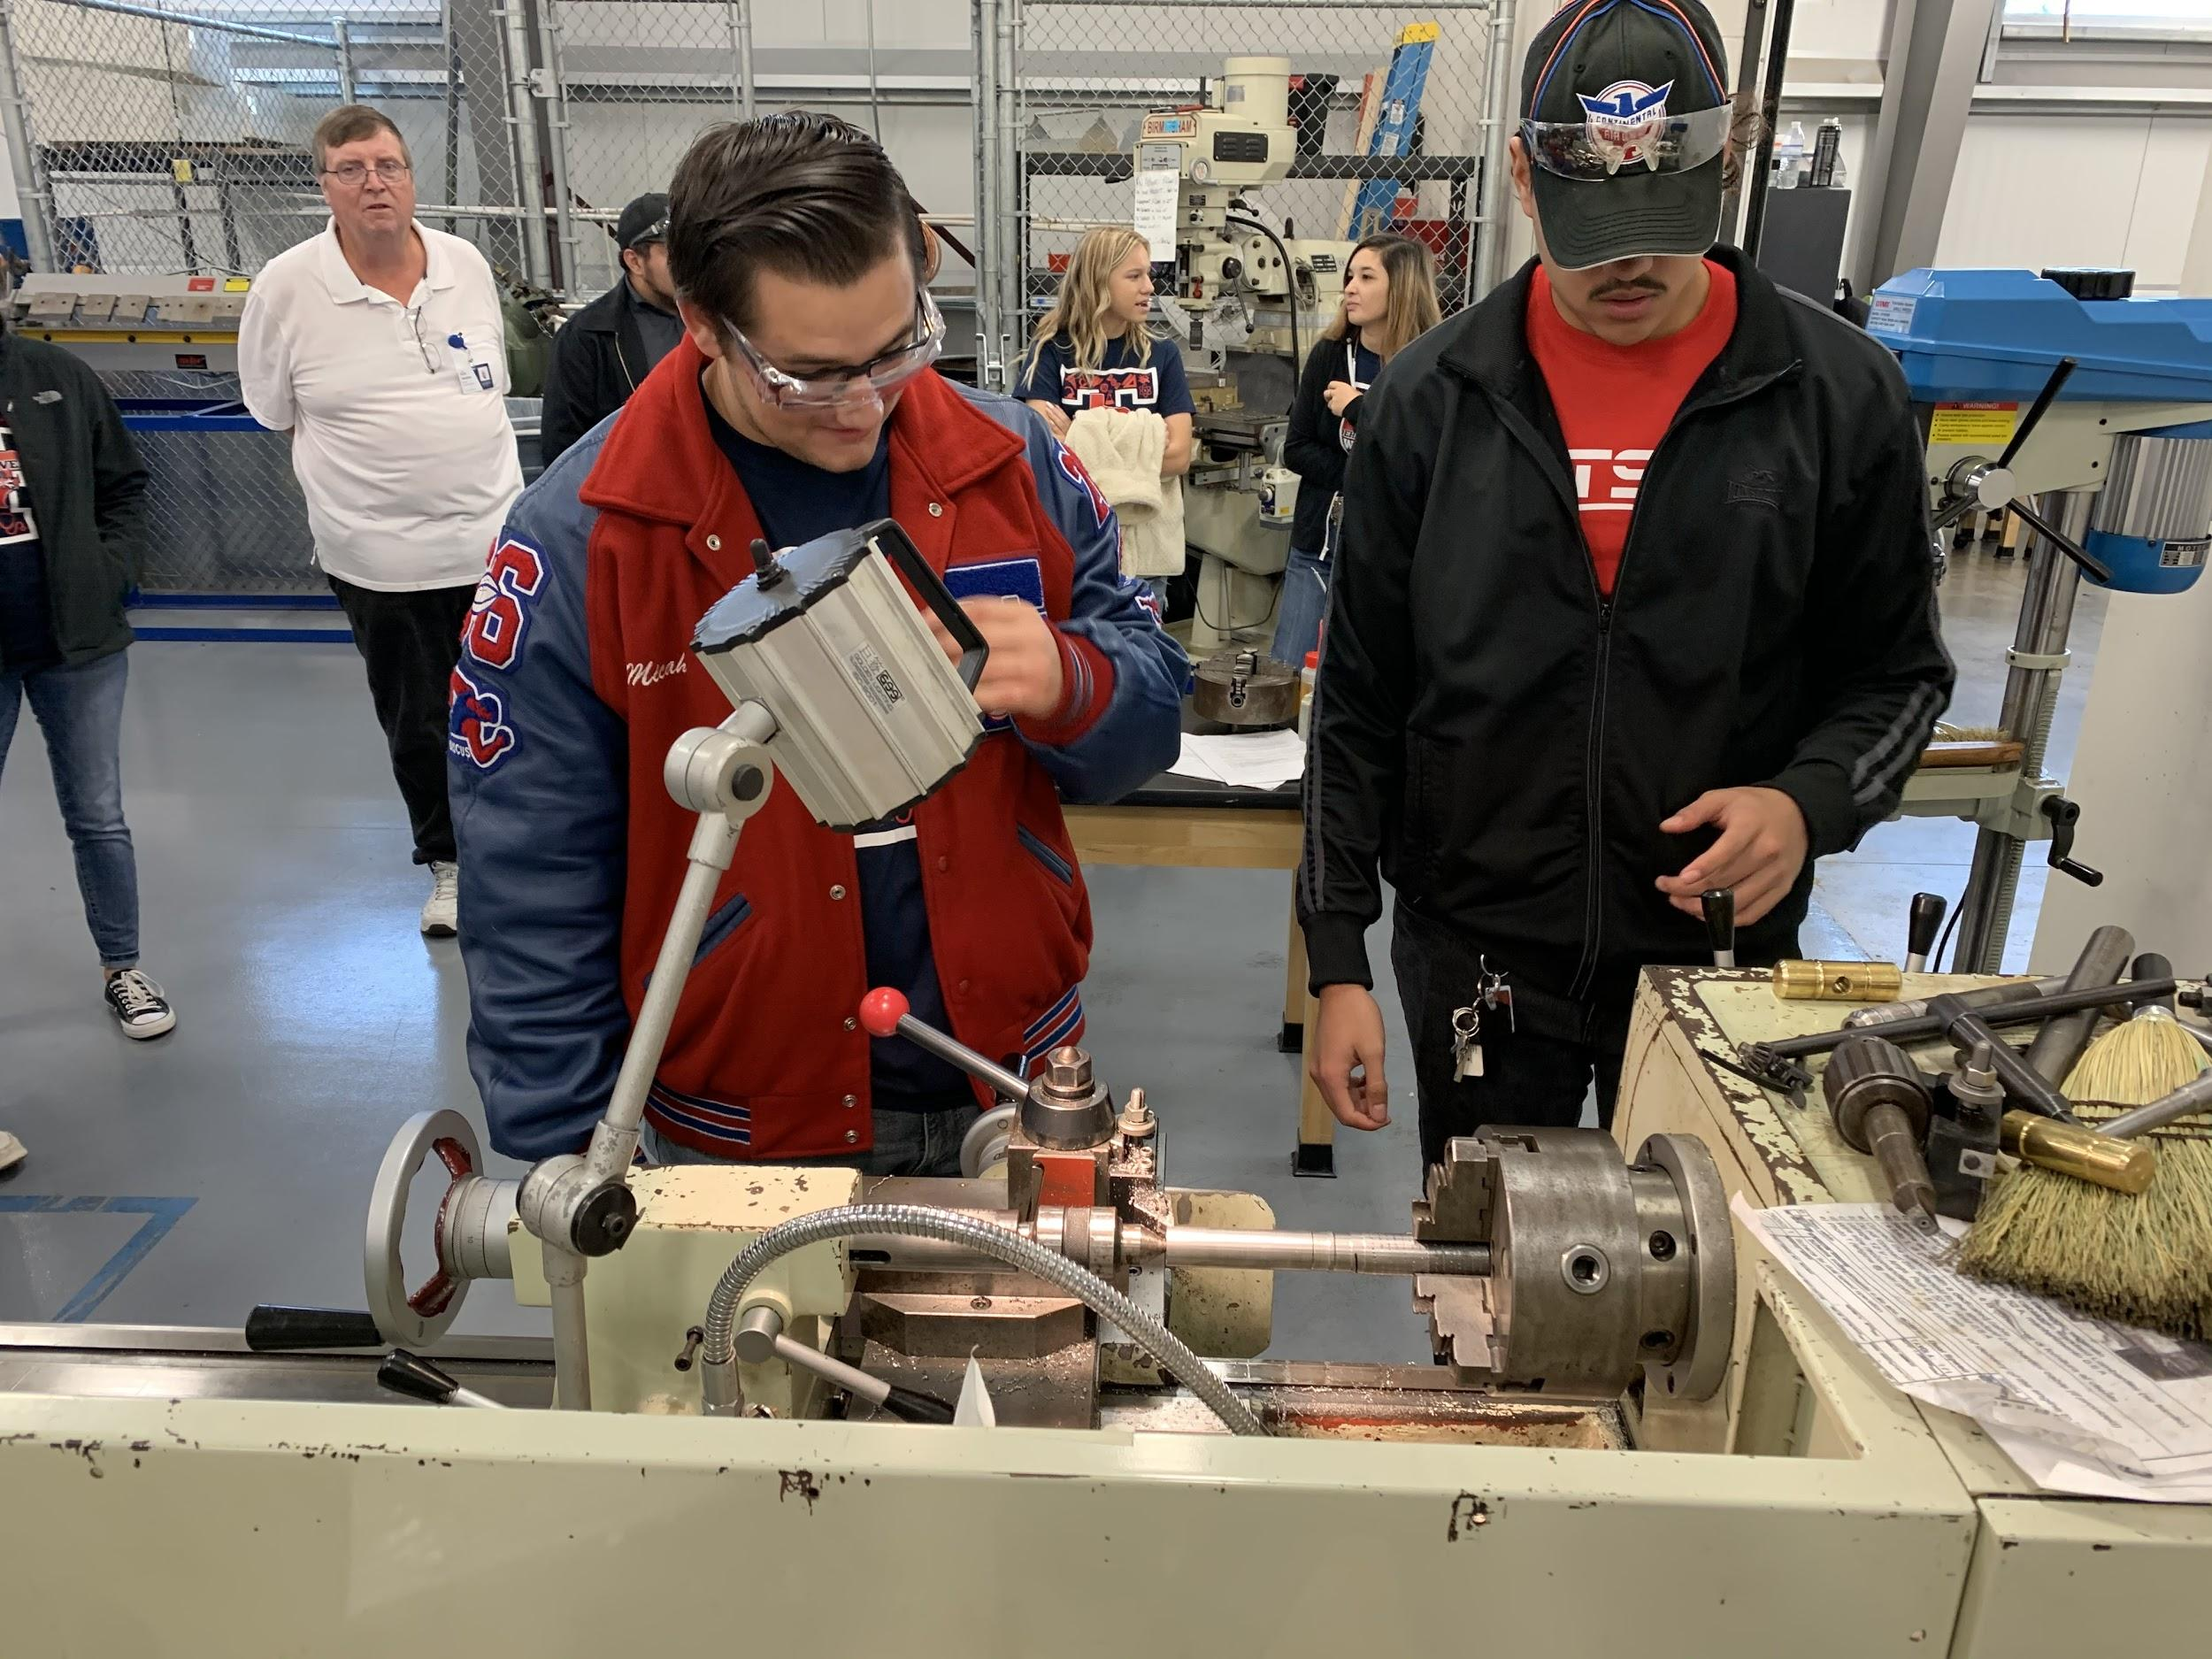

Slide 6
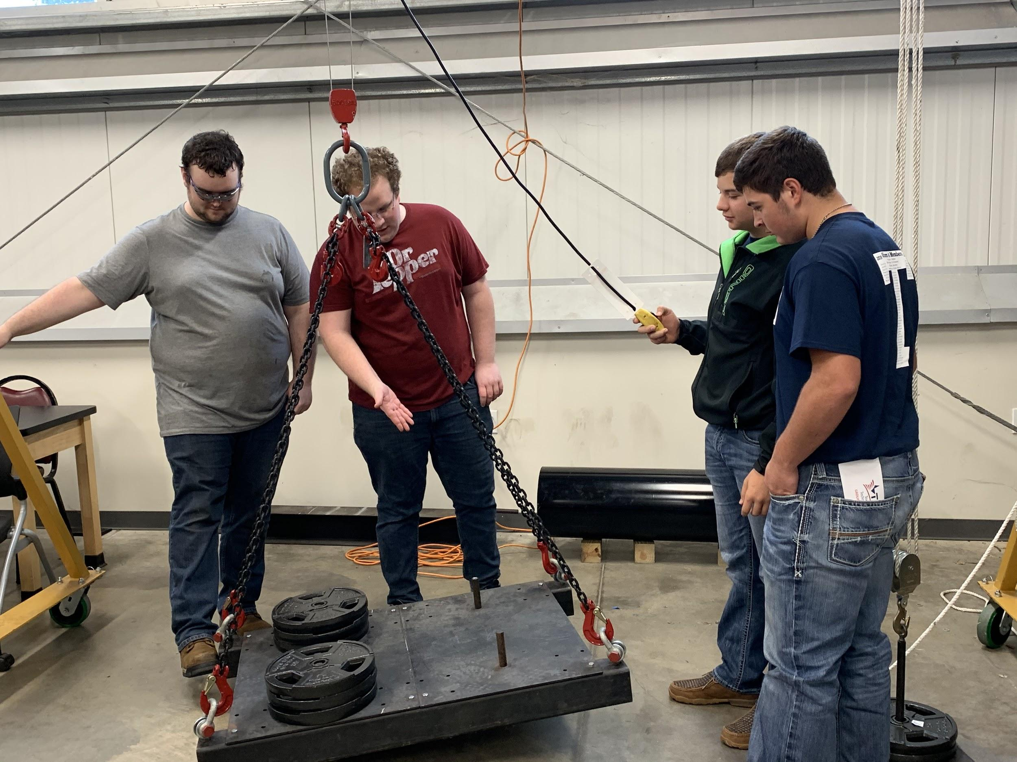

Slide 7
Tidehaven WIT
2018-2019

Slide 8
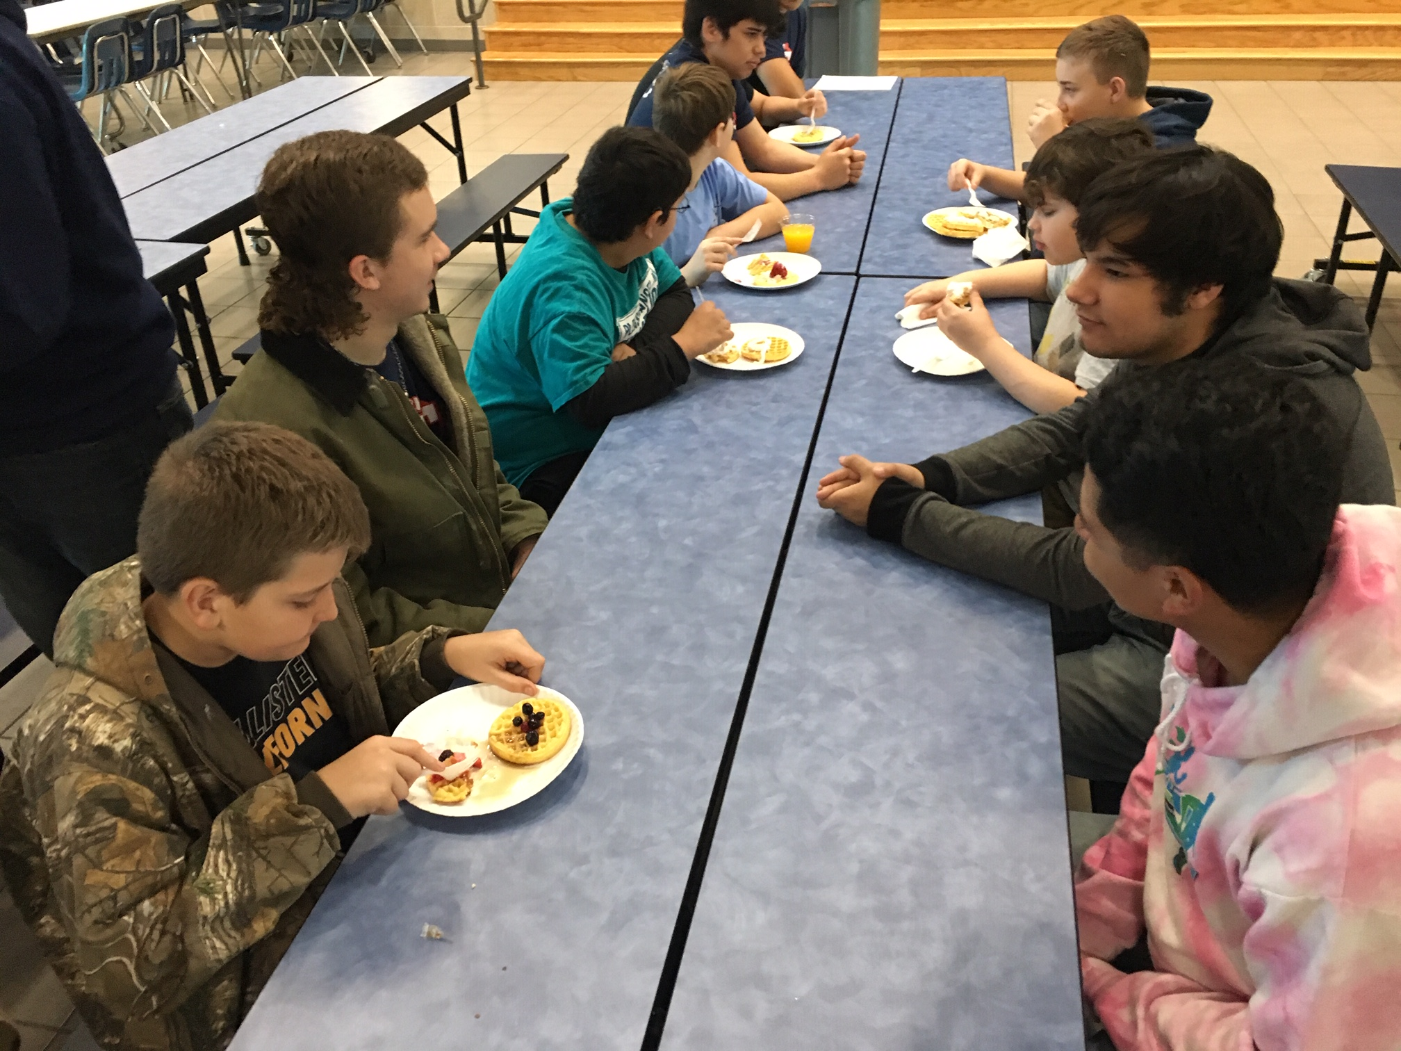
Breakfast with Boys Resourcing Technology

Slide 9
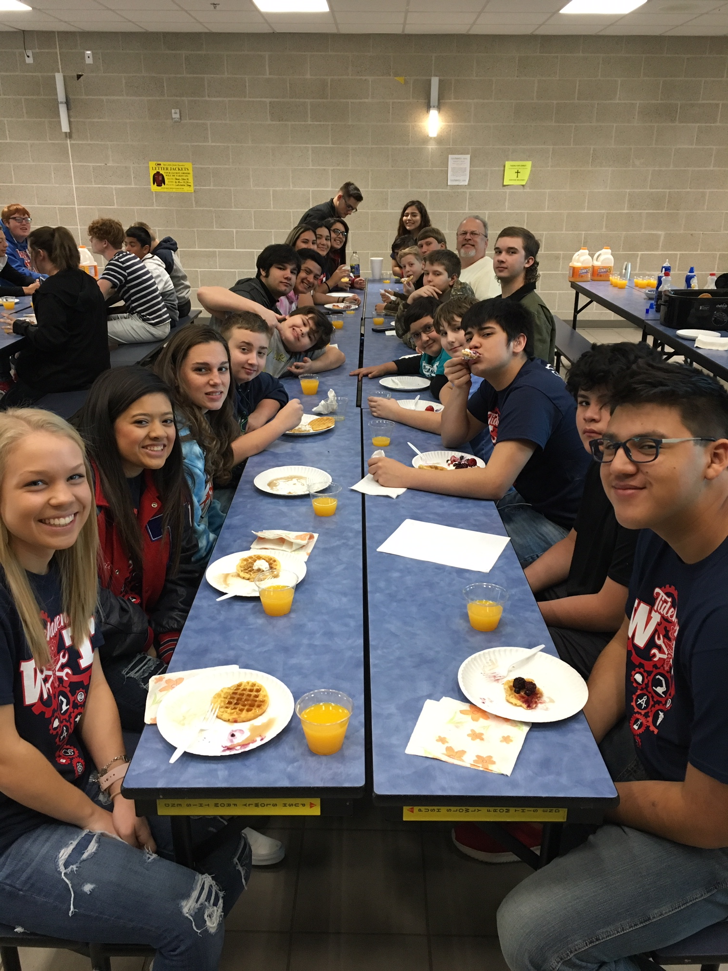
Breakfast with Boys Resourcing Technology

Slide 10
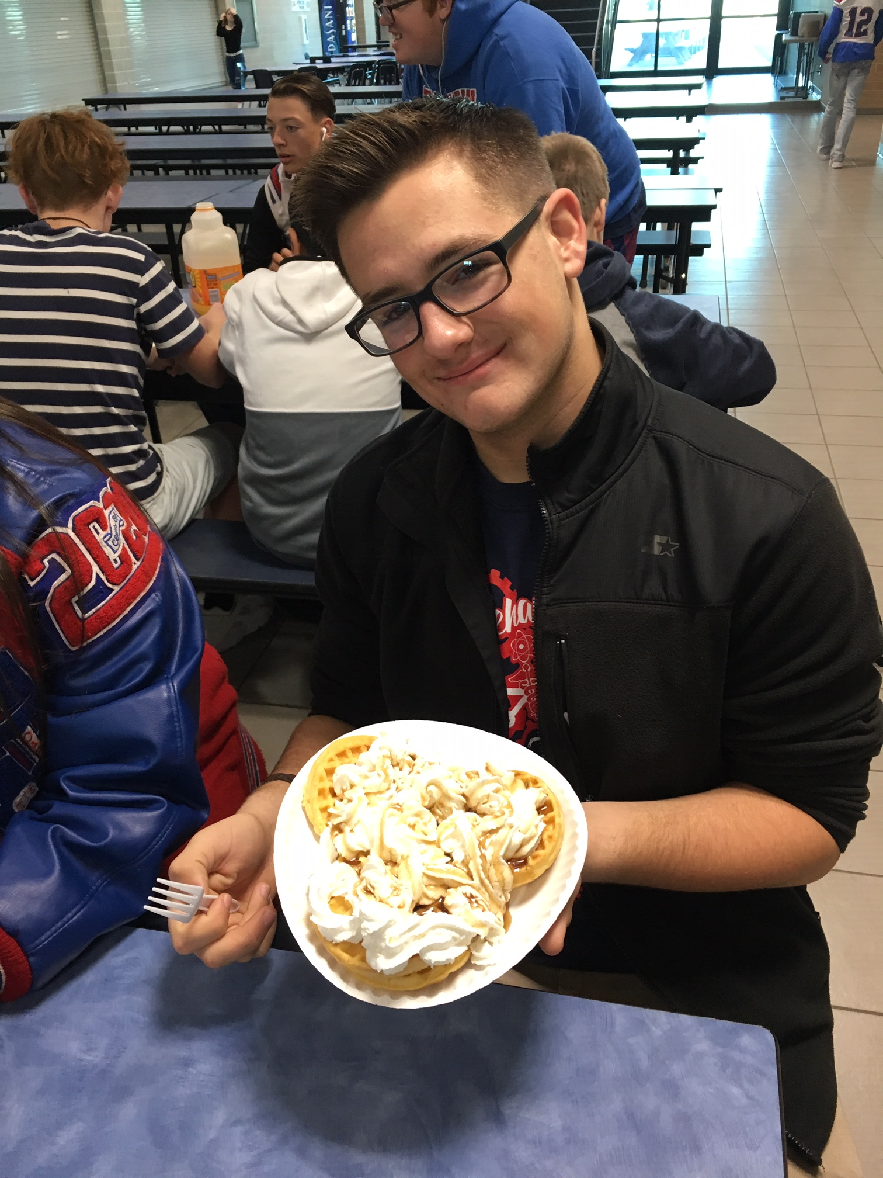
Breakfast with Boys Resourcing Technology

Slide 11
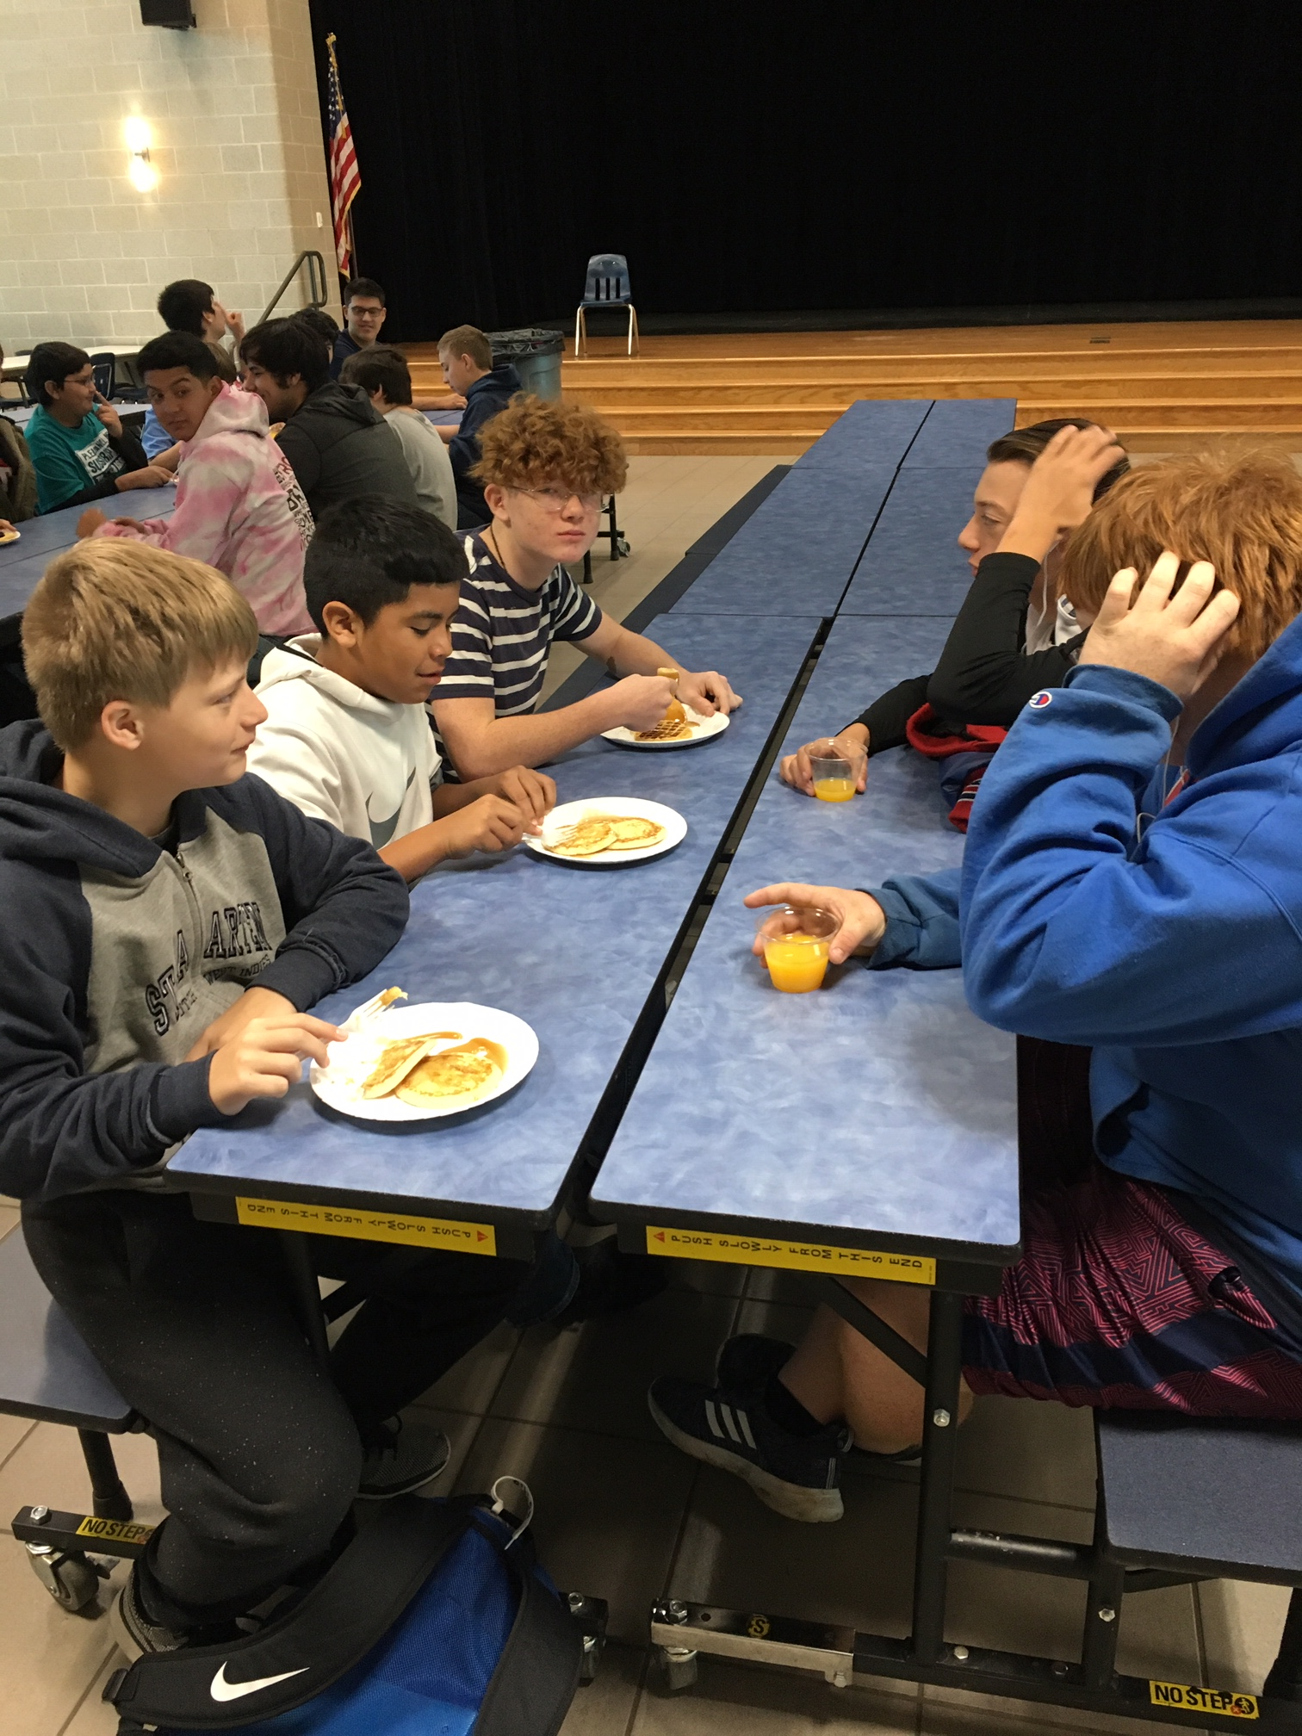
Breakfast with Boys Resourcing Technology

Slide 12
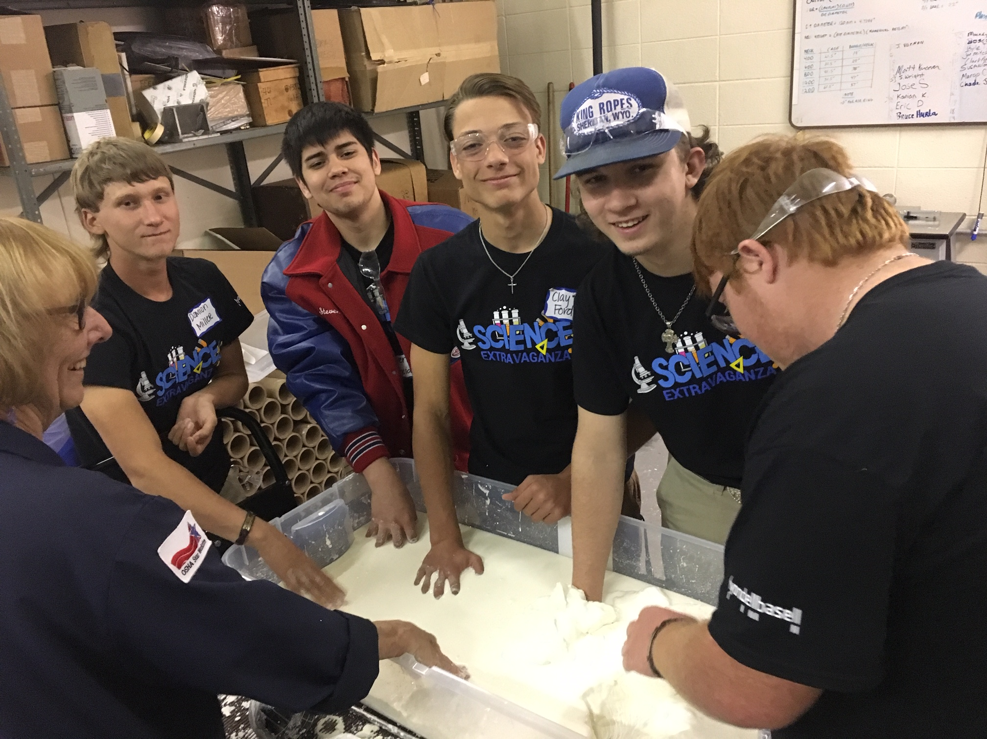
WIT students toured LyondellBassel

Slide 13
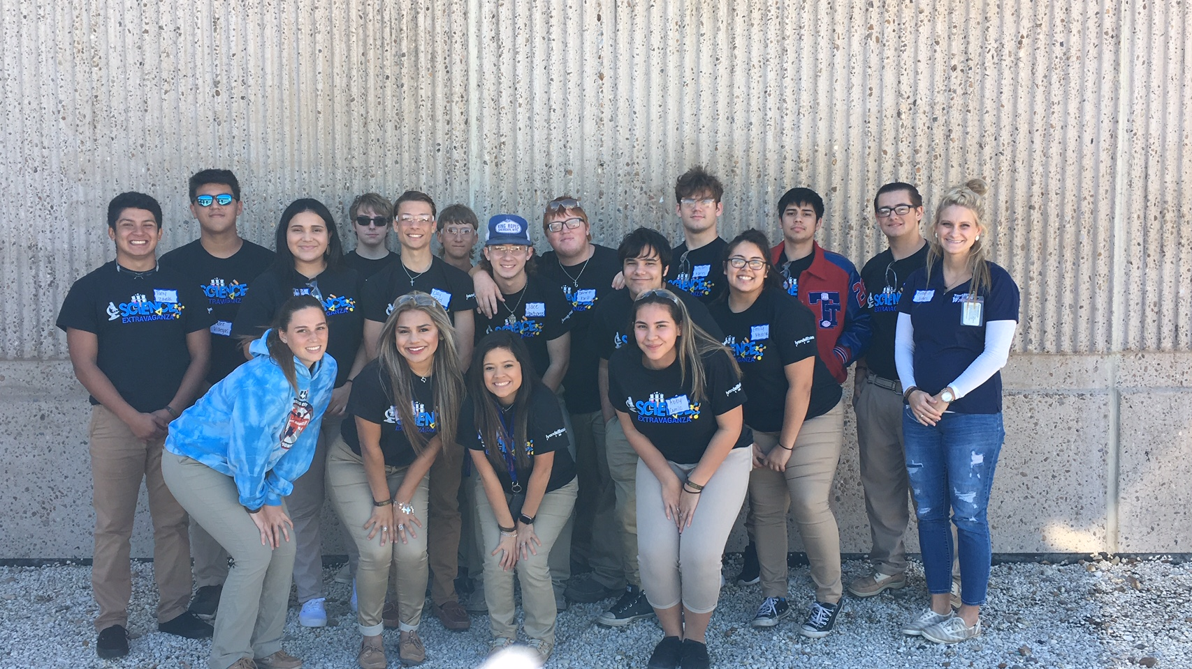
WIT students toured LyondellBassel

Slide 14
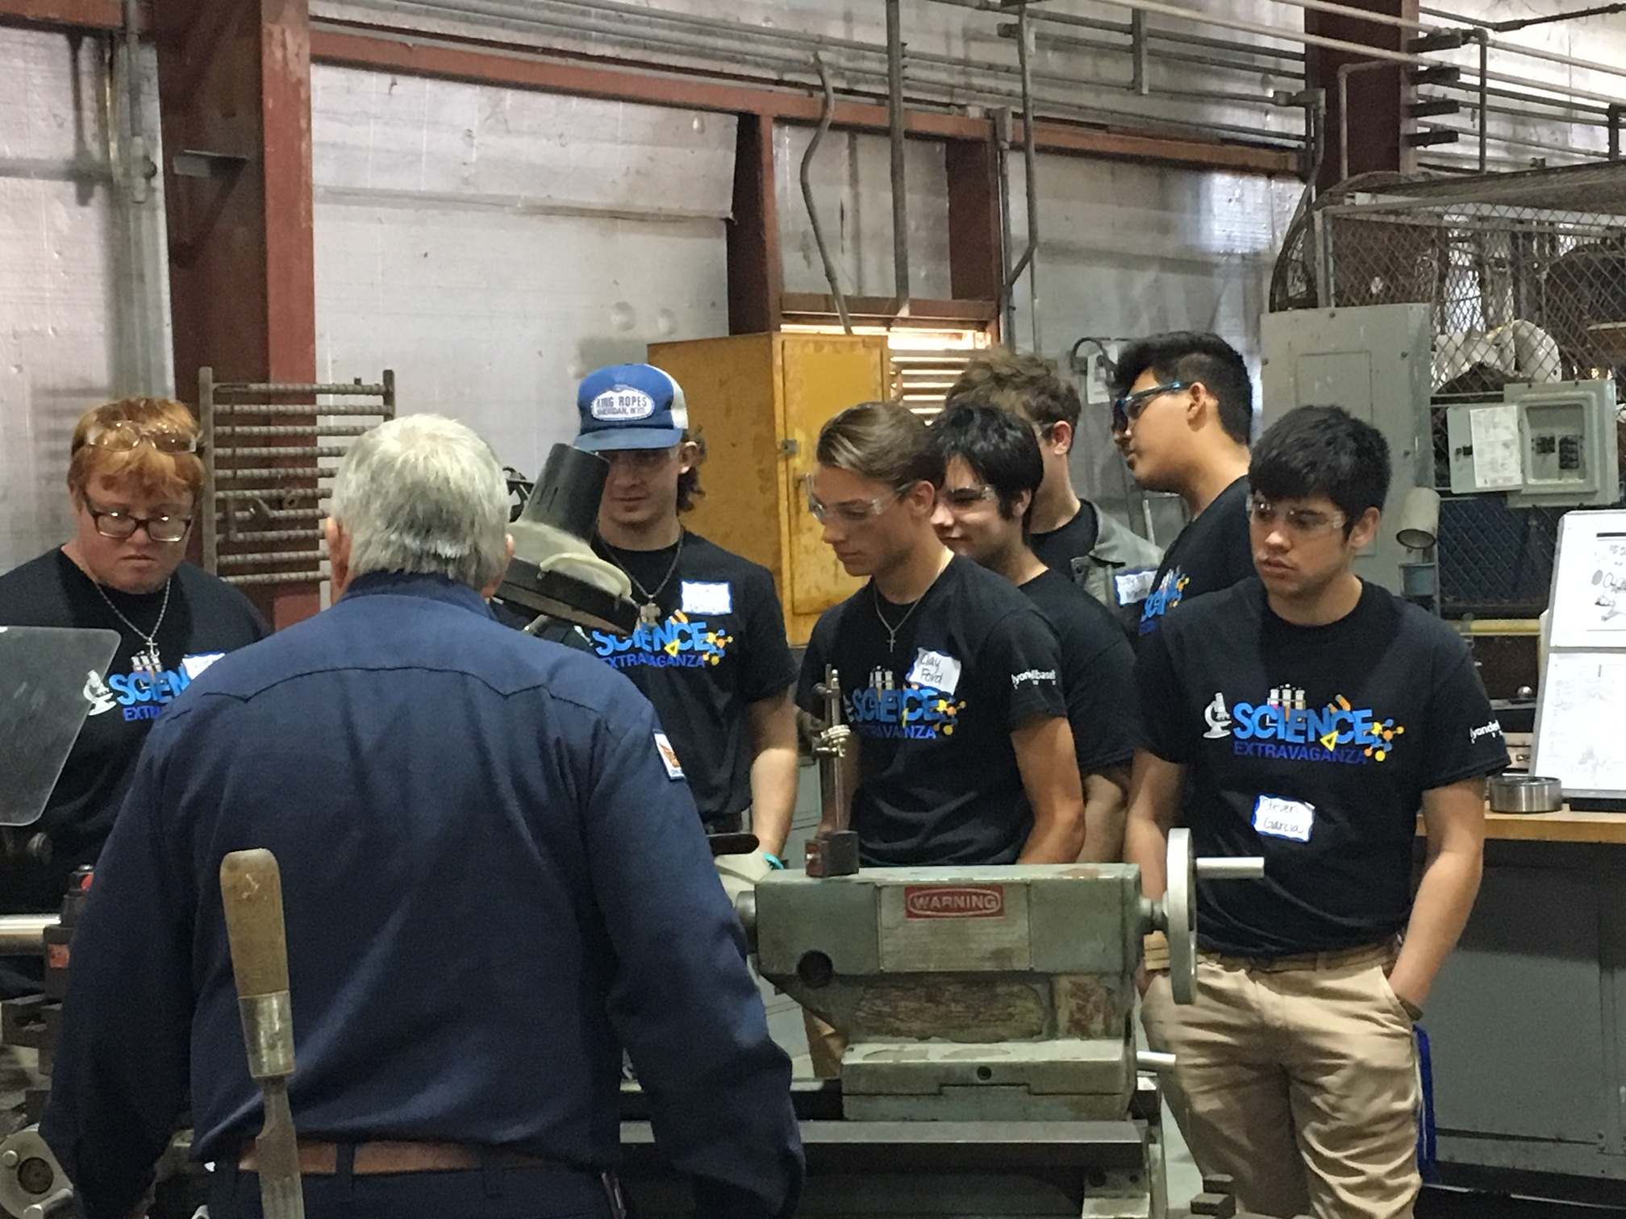
WIT students toured LyondellBassel

